Slide 1

Capstone Project Phase 1
Crop Ripeness Identification by Analysis of Drone Video Stream
23-1-D-22
Supervisors: Dr Dan Lemberg, Mrs. Elena Kramer
Ori Malka, Alexander Martinov

Slide 2
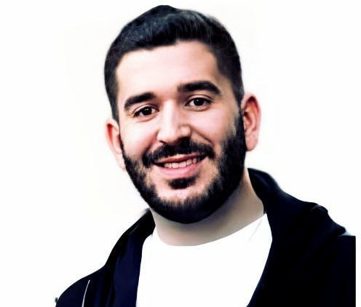

Team
Ori Malka
Alexander Martinov

Slide 3

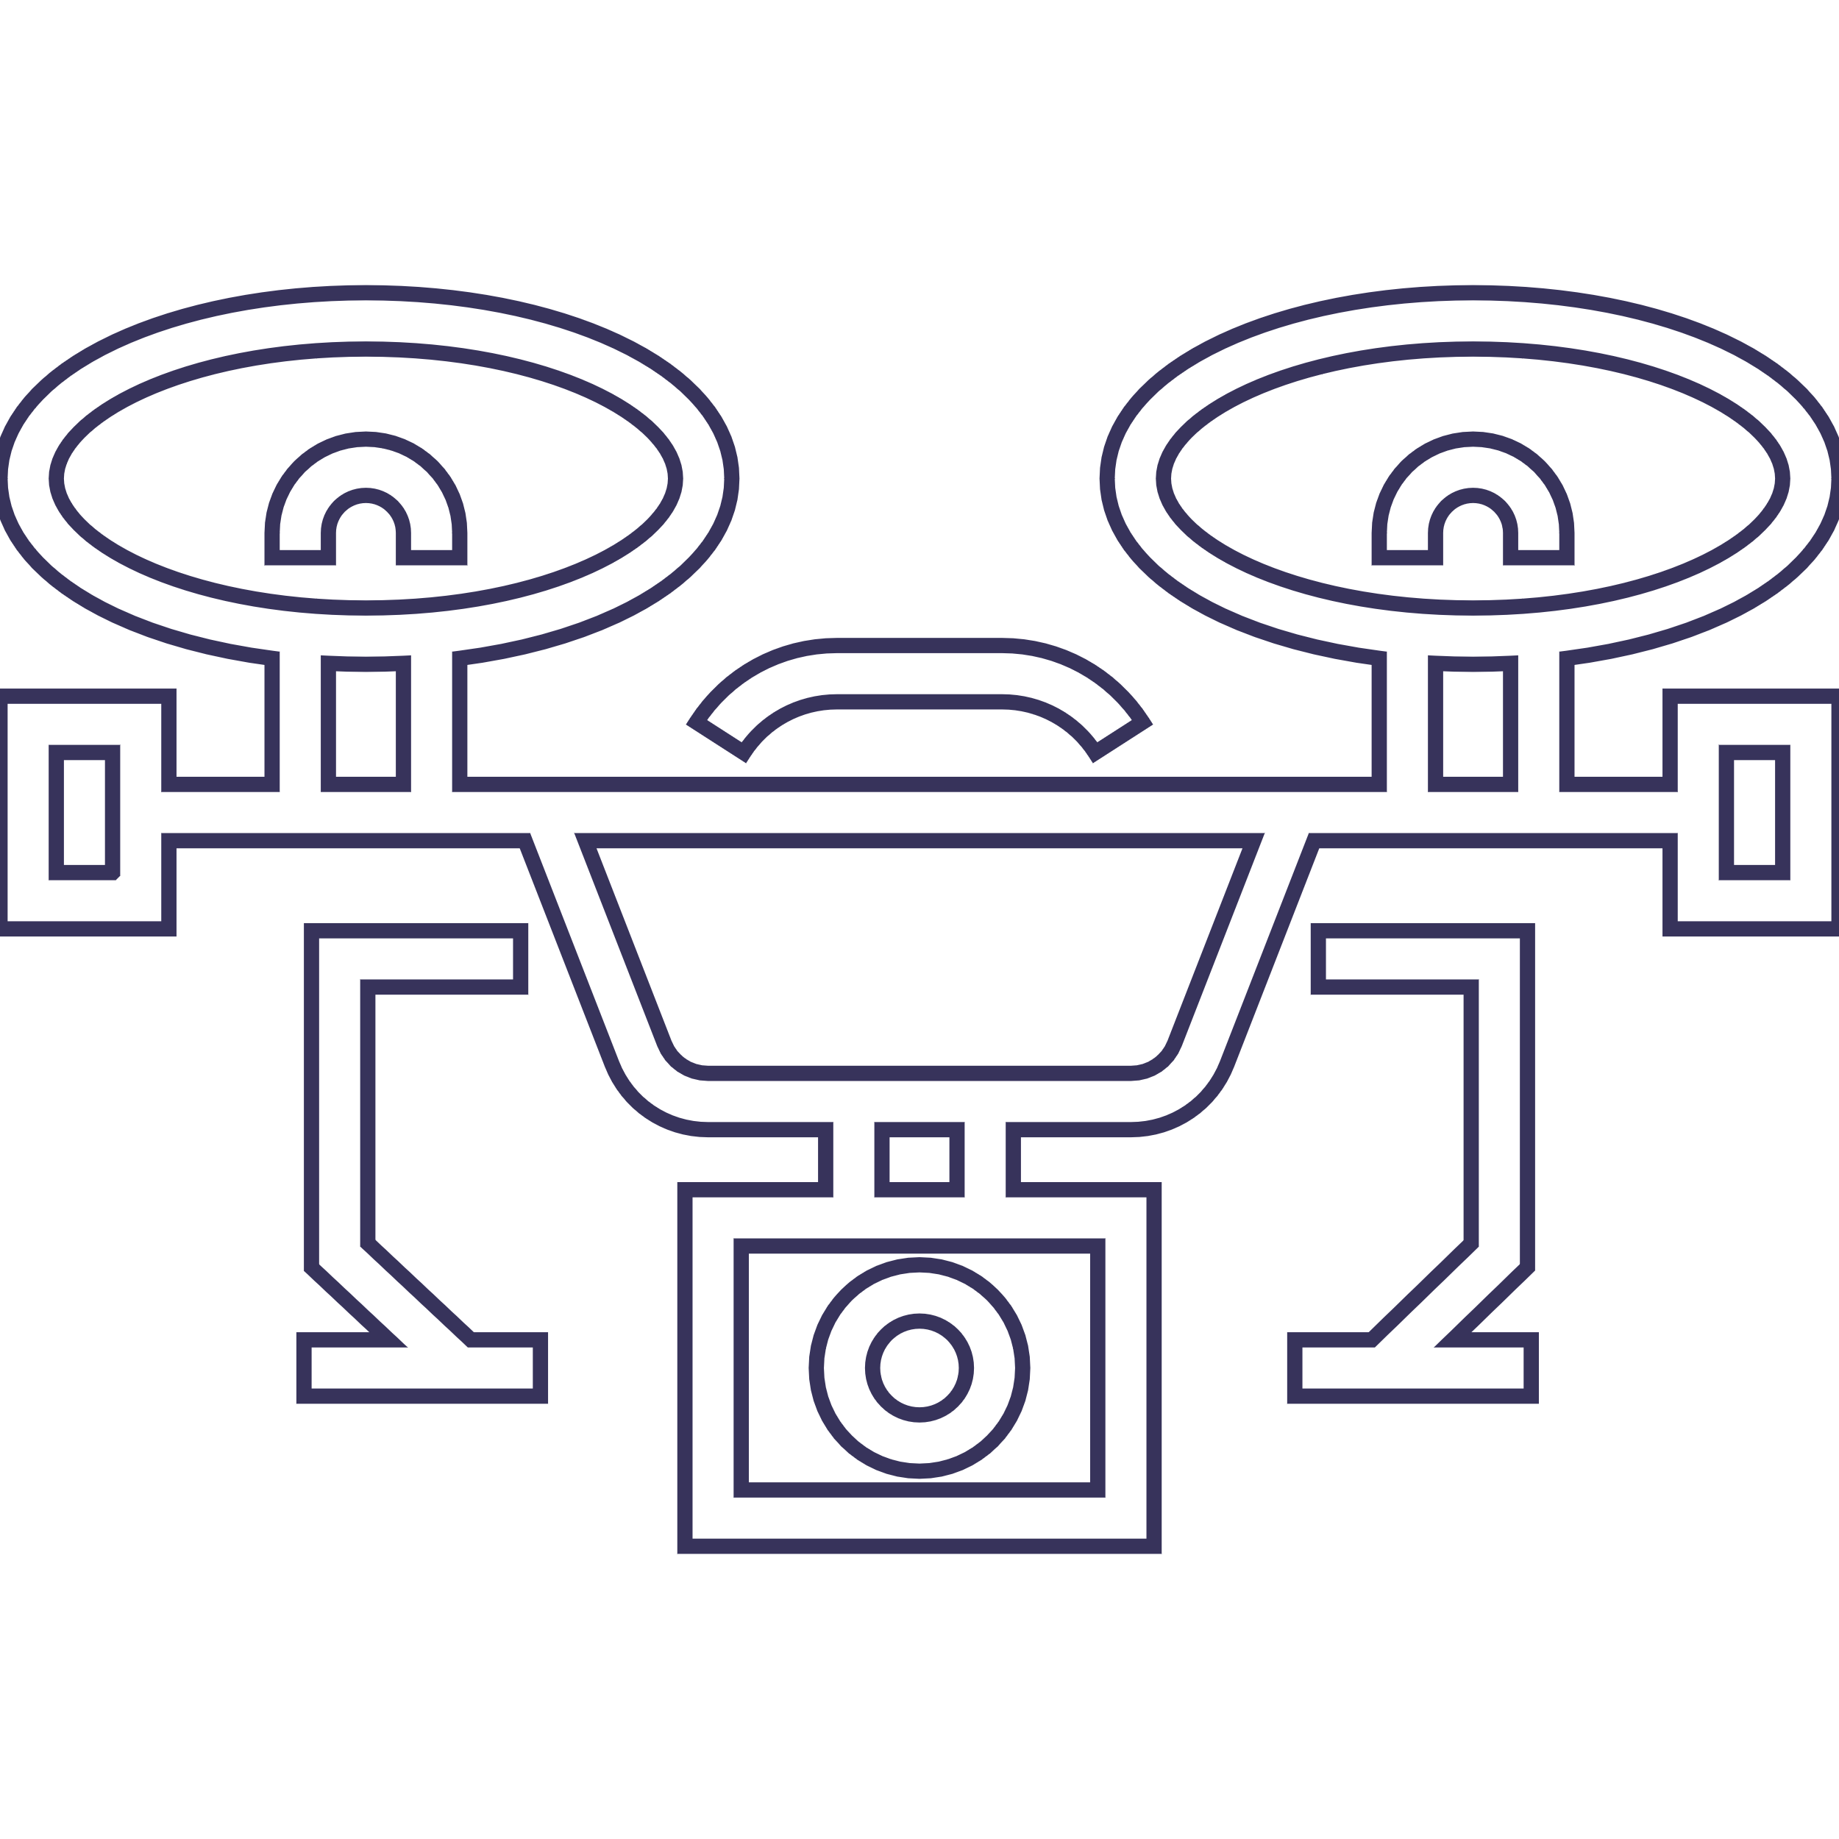

Agenda
Introduction.
The Solution.
Our System.
Architecture Overview.
4.1. Drone.
4.2. User Interface.
4.3. Models Architecture/Pipeline.
4.4. Ground Control Unit.
Verification Plan.
GUI Screens

Slide 4
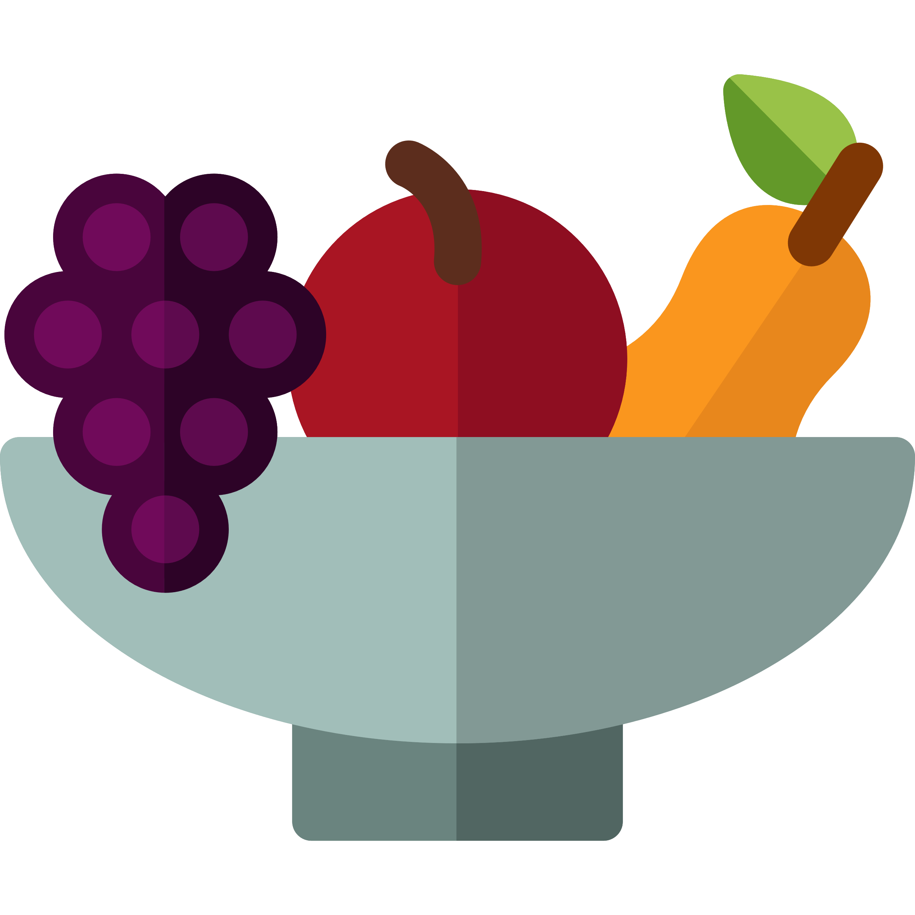
Introduction
Crop farming is considered the great initiator of civilization.
Farmland become bigger and harder to manage due to the ever-increasing demand for affordable, high-quality, available food.

Slide 5

Introduction
Crop management is critical for modern agriculture because it impacts crop yield.
One promising approach in crop management is the use of drones equipped with deep-learning algorithms to identify the ripeness of crops.

Slide 6

The Solution
The main goal of this project is to develop a system for crop management in the aspect of monitoring the crop quantity and ripeness and optimizing its harvesting routes.
Our system will be able to scan a given farmland and analysis its crop quantity and ripeness in a sort of “heat-map” output.

Slide 7
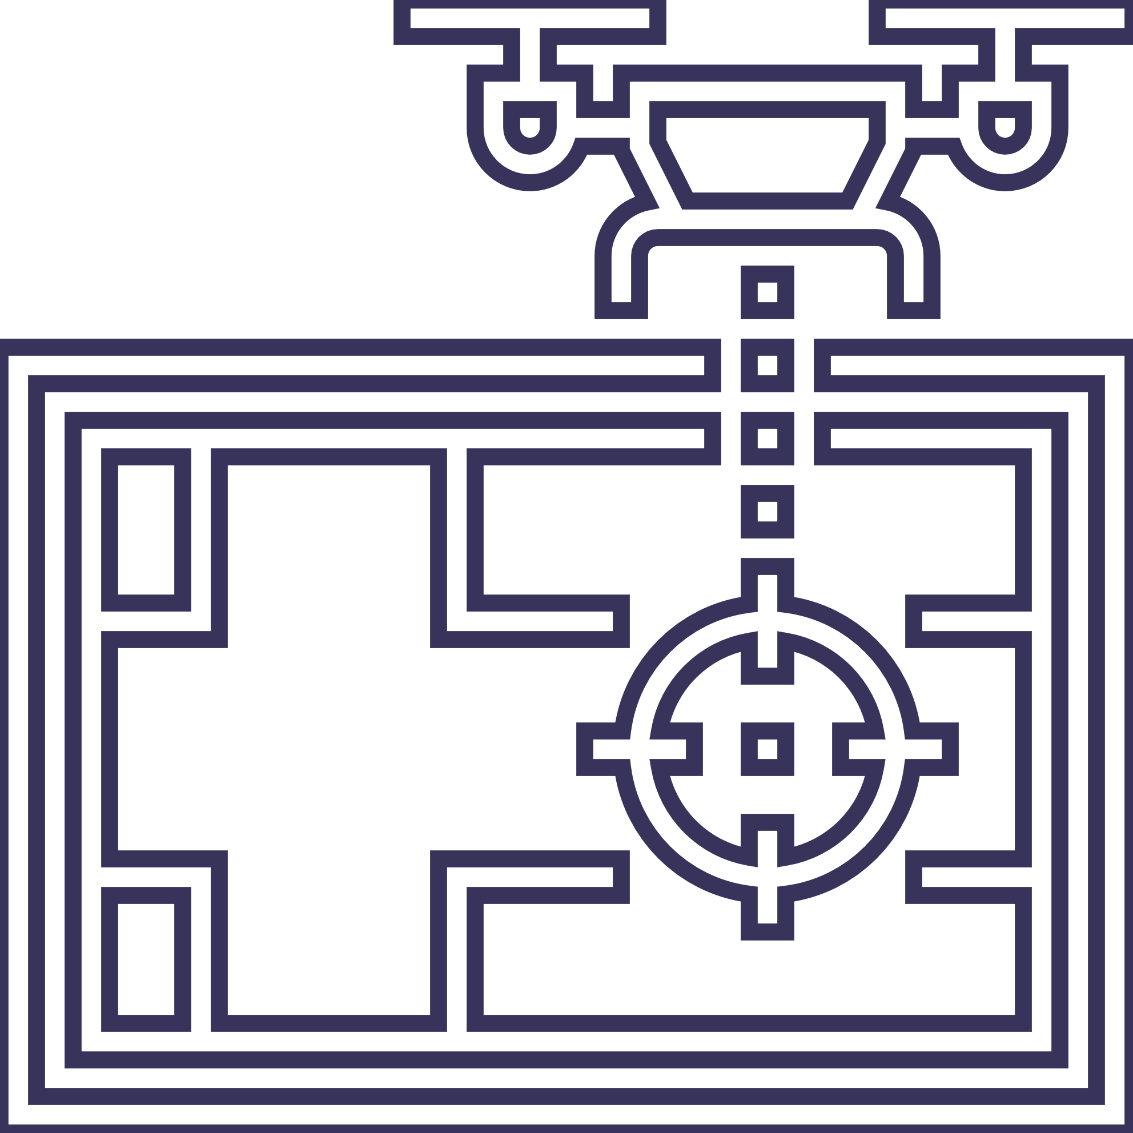
Our System
Our system generates the drone flying route by analyzing a GPS map that was given by the user.
While the drone is flying, the Ground Control Unit (GCU) communicates with it for progress evaluation and route adjustments.
The drone video stream is processed in real-time with our novel video processing models pipeline that is built from YOLO and our CNN for ripeness classification.

Slide 8
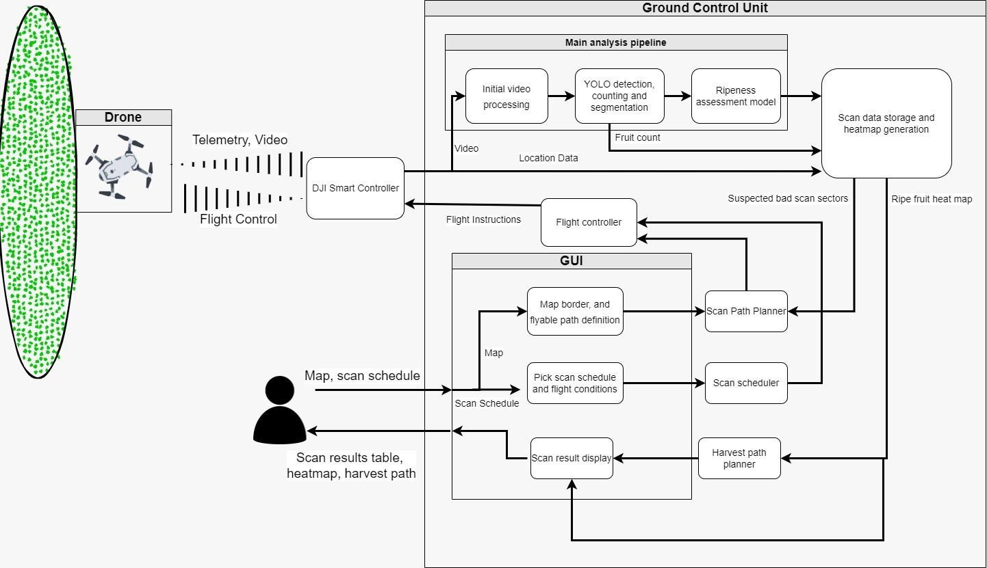
Architecture Overview
Notes:
Drone scanning the crops.
GCU processes the drone’s video.
GUI for defining the flyable areas, scheduling scans, and displaying scan results.
Machine learning pipeline for processing the video, consisting of YOLO and our CNN ripeness model.

Slide 9
Drone
The drone will oversee the physical aspect of our project, by flying through the fields on the previously defined flight paths.
The drone and the GCU will be in constant communication through the DJI Smart Controller (Using DJI API).
We think that a flexible and easy-to-use drone control and communication API is key for project success.
This requires addressing issues such as distance and range, interference, and latency in the communication link.

Slide 10
User Interface (UI)
The UI will allow three main functions:
Provide a GPS map of the farmland.
Schedule scans (manual/periodic).
Displaying of scan results.
Notes:
Provide a GPS map of the farmland, and mark on the map scan relevant features, such as farm borders, flyable areas, and crop areas for scanning. This information will be further used for planning out a scan path for the drone by using a traversal algorithm and building a crop heatmap.
Scheduling scans, whether manual or periodic, with the option to add triggers and conditions such as postponing a scan due to bad weather conditions for a flight.
Displaying of scan results, the results will consist of a table with information such as total fruit count, ripe fruit count, and percentage and areas that required additional scans. In addition, after a complete scan we will generate and display a heat map of ripe fruit sectors overlayed on top of the map provided by the user, with a suggested optimal path for the harvest of hotspots.

Slide 11
Models Pipeline - I
High-level explanation:
The model pipeline will consist of a video stream input from the drone.
This video stream will be processed by a YOLO model.
The YOLO model will detect fruit objects and send their segmentation to our CNN-based model for fruit ripeness assessment.

Slide 12
Models Pipeline - II
YOLO:
We will use YOLO for fruit detection, counting, and segmentation of individual fruits captured on video.
Our YOLO version needs to detect fruits in real-time from an aerial POV.
Therefore, we will have to test several types of YOLO (SEG-YOLO, YOLOx, etc.).
Notes:
*

Slide 13
Models Pipeline - III
Fruit ripeness model:
Our model is CNN-based for fruit ripeness assessment from segmented fruit images (image classification model).
We will train the model on a unique dataset that consists of citrus fruit images in different ripeness stages (labeled – supervised training).
This dataset will be built by us during the second stage of the project.
Notes:
*

Slide 14





Ground Control Unit (GCU)
The GCU will provide the following functions:
The GCU will be an on-location server with a wired connection to the DJI Smart Controller.
The GCU is the “brain” of the operation, handling the drone control, image processing, and UI aspects of our project.
The GCU will also tie the ripe fruit detections to the current drone location on the planned flight path.

Slide 15
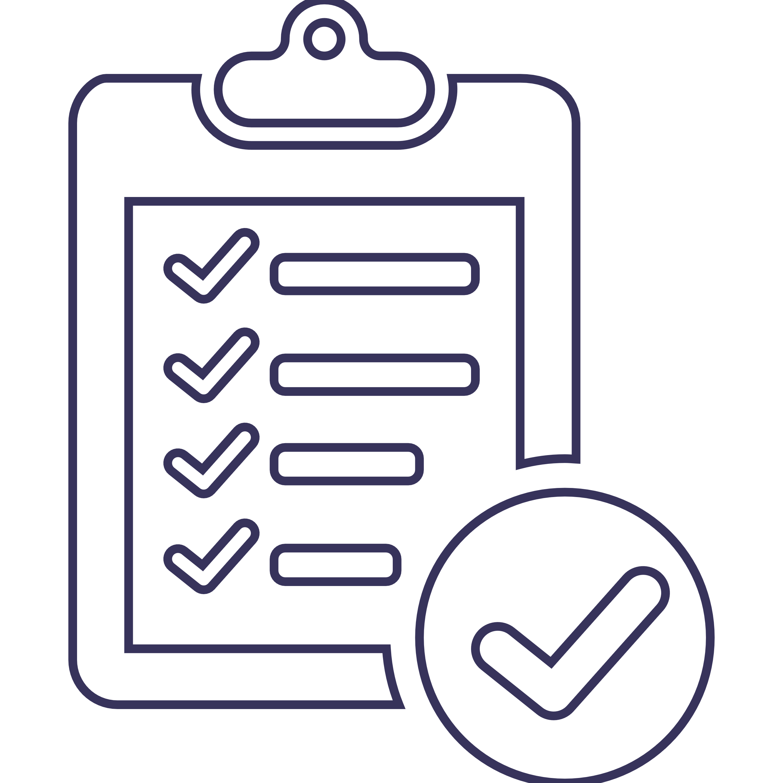
Verification Plan
User Interface – map loading, map marketing, flight schedule, and displaying of data.
Ground Control Unit – drone control, drone connection, video reception from the drone, path planning, running the model pipeline, detection of faulty path sections, and heatmap generation.
Model Pipeline – YOLO detection and segmentation and our CNN ripeness model predictions.
Drone – localization, video feed, reception, and API.

Slide 16
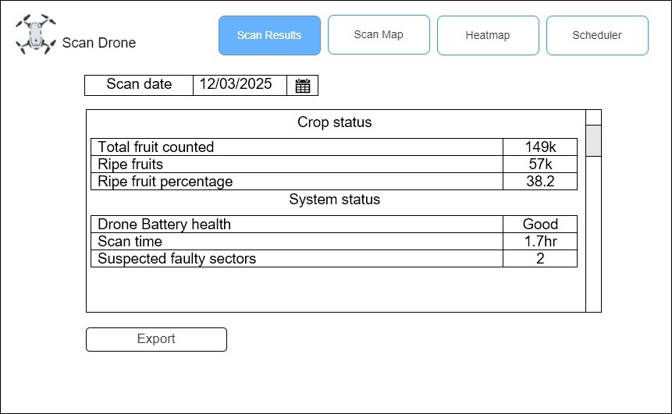
GUI Screens
Scan Results

Slide 17
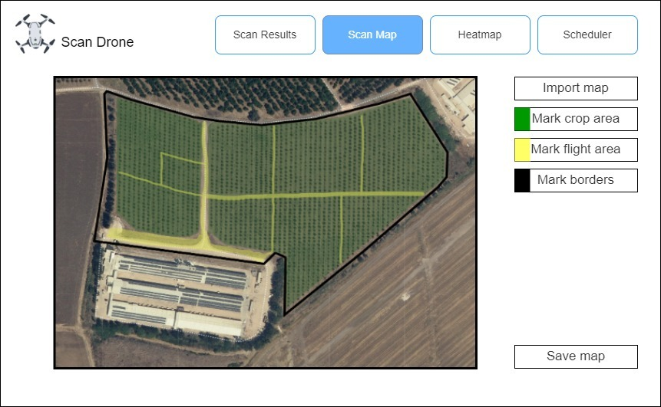
GUI Screens
Scan Map

Slide 18
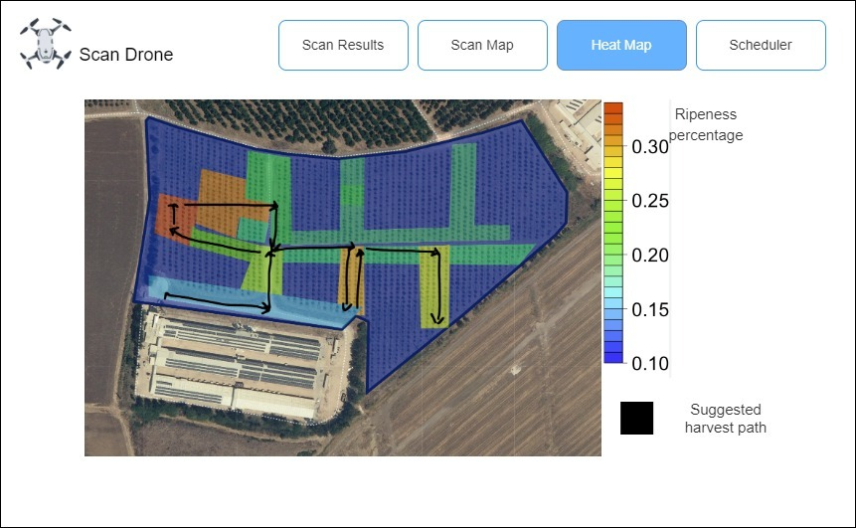
GUI Screens
Heatmap

Slide 19
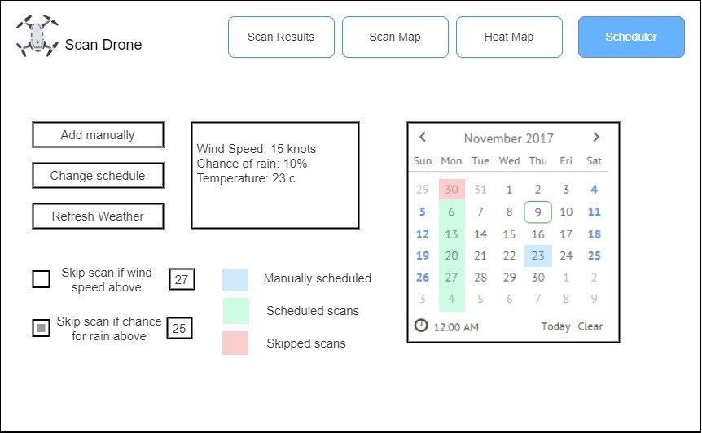
GUI Screens
Scheduler

Slide 20
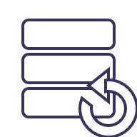
Backup

Slide 21
Development Process
The development process will consist of the following steps:
Taking pictures of fruit for a ripeness assessment model dataset.
Developing a basic drone communication and control module.
Developing a module for planning out a scanning route given a map.
Training a YOLO model for fruit detection and segmentation.
Developing a CNN-based model for fruit ripeness assessment given segmented image.
Integrating full scan and detection pipeline.
Creating a simple UI for defining the paths clear for flying on a map.
Creating a simple UI for scheduling scans and displaying scan results.

